Slide 1
MODULE - 5
Transactions, Concurrency and Recovery, Recent Topics

Slide 2
SYLLABUS
Transaction Processing Concepts - overview of concurrency control, Transaction Model, Significance of concurrency Control & Recovery, Transaction States, System Log, Desirable Properties of transactions.
Serial schedules, Concurrent and Serializable Schedules, Conflict equivalence and conflict serializability, Recoverable and cascade-less schedules, Locking, Two-phase locking and its variations. Log-based recovery, Deferred database modification, check-pointing.
Introduction to NoSQL Databases, Main characteristics of Key-value DB (examples from: Redis), Document DB (examples from: MongoDB)
Main characteristics of Column - Family DB (examples from: Cassandra) and Graph DB (examples from : ArangoDB)

Slide 3
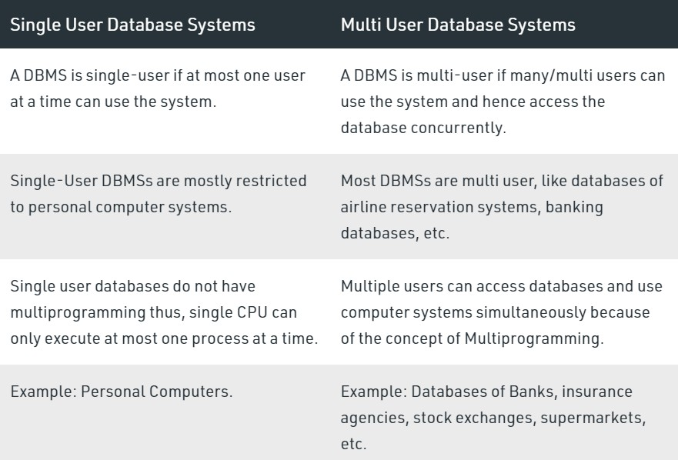
Single-User versus Multiuser Systems

Slide 4
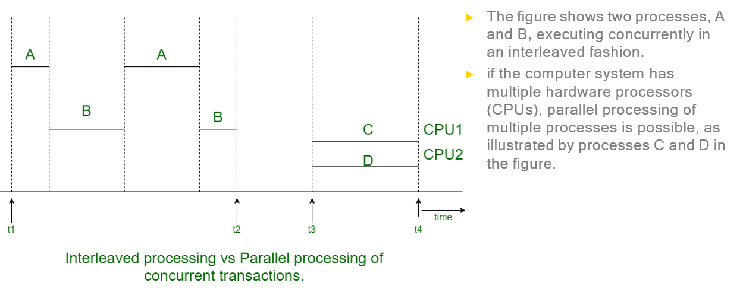
Overview of Concurrency Control and Recovery
Concurrency may be achieved by Interleaved Processing, where processes are executed in an interleaved fashion with a single CPU or by Parallel Processing, where processes are concurrently executed in multiple CPUs.

Slide 5
Transaction
A Transaction is a Logical unit of database processing that includes one or more access operations.
These can include insertion, deletion, modification, or retrieval operations.
If the database operations in a transaction do not update the database but only retrieve data, the transaction is called a read-only transaction; otherwise it is known as a read-write transaction.
A database is basically represented as a collection of named data items.
The size of a data item is called its granularity.
A data item can be a database record, but it can also be a larger unit such as a whole disk block or even a smaller unit such as an individual field (attribute) value of some record in the database.
The transaction processing concepts are independent of the data item granularity (size) and apply to data items in general.

Slide 6
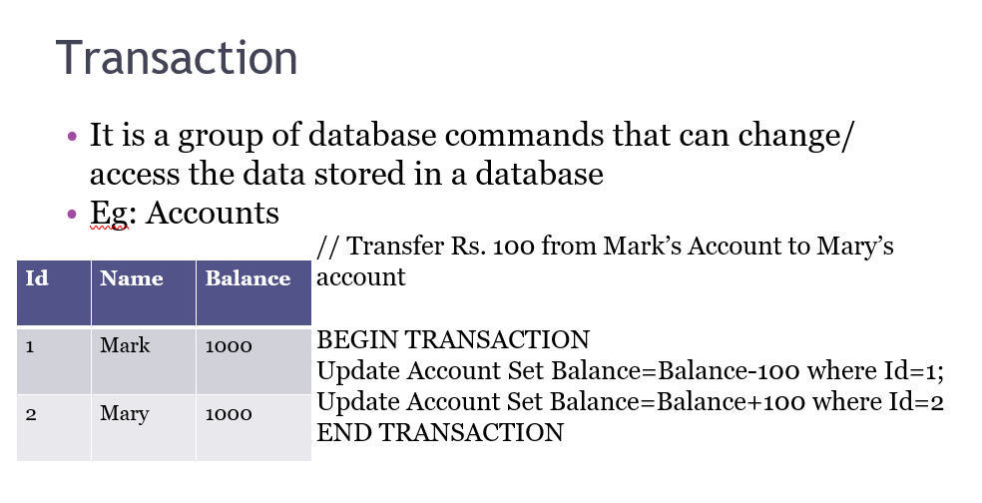
A transaction is treated as a single unit of work- either all statements are succeeded or none of them
Transaction maintains integrity of data in a database
Eg, Transfer Rs. 100 from A to B:
Transaction boundaries:
▫
Begin and End transaction.

Slide 7
TERMINOLOGY
• BEGIN TRANSACTION - Beginning of transaction execution
• END TRANSACTION - Transaction execution is completed
• ROLLBACK_TRANSACTION(ABORT) - This signals that the transaction has ended unsuccessfully, so that any changes made by that transaction must be undone
• COMMIT_TRANSACTION - Signals successful end of the transaction. All changes made by the transaction are recorded permanently in the database and will not be undone

Slide 8
The basic database access operations that a transaction can include are as follows:
read_item(X): command includes the following steps:
Find the address of the disk block that contains item X.
copy that disk block into a buffer in main memory (if that disk block is not already in some main memory buffer).
Copy item X from the buffer to the program variable named X.
2. write_item(X) command includes the following steps:
Find the address of the disk block that contains item X.
Copy that disk block into a buffer in main memory (if that disk block is not already in some main memory buffer).
Copy item X from the program variable named X into its correct location in the buffer.
Store the updated block from the buffer back to disk (either immediately or at some later point in time).

Slide 9
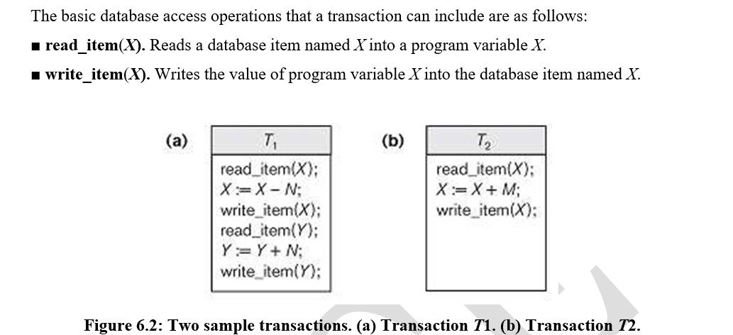

Slide 10
Why Concurrency Control is Needed?
When multiple transactions execute concurrently in an uncontrolled or unrestricted manner, then it might lead to several problems.
These problems are commonly referred to as concurrency problems in database environment.
The five concurrency problems that can occur in database are:
Temporary Update Problem
Incorrect Summary Problem
Lost Update Problem
Unrepeatable Read Problem

Slide 11
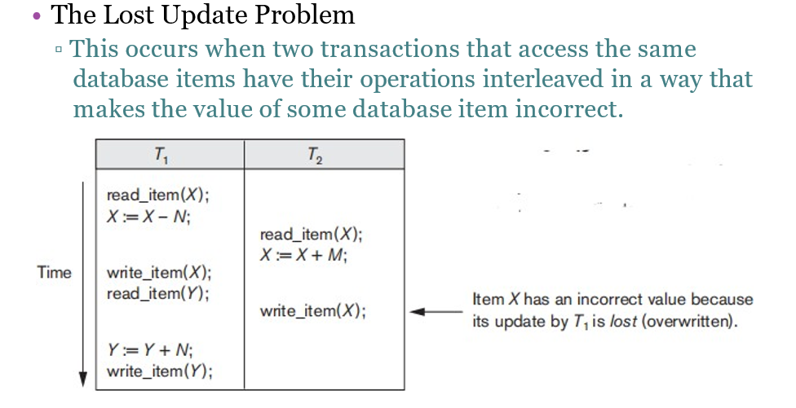

Slide 12
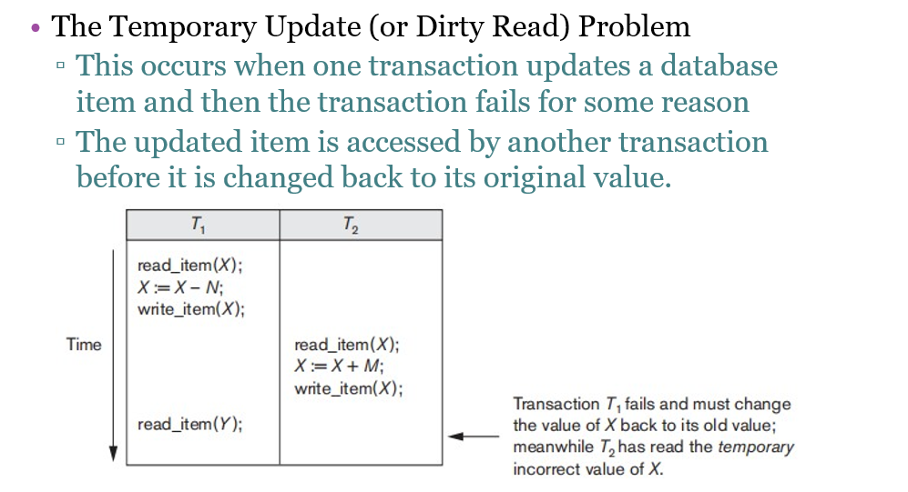

Slide 13
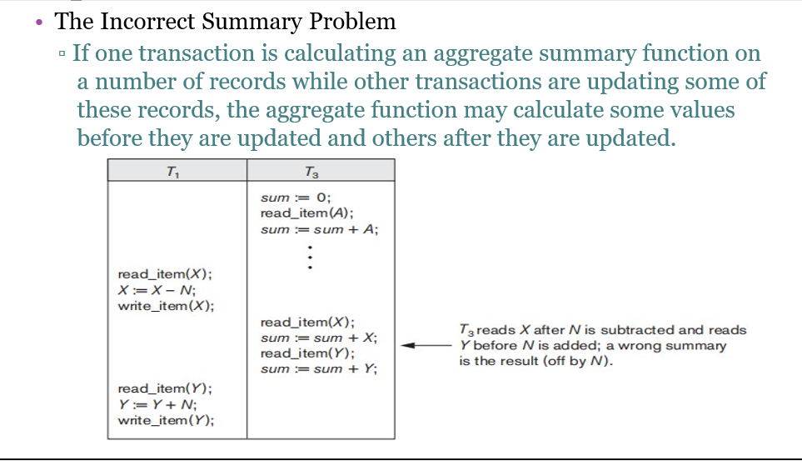

Slide 14
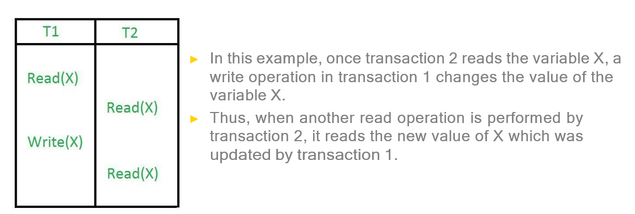
The unrepeatable problem
The unrepeatable problem occurs when two or more read operations of the same transaction read different values of the same variable.

Slide 15
Why Recovery is Needed?
Types of Failures
1. A computer failure (system crash): A hardware or software error occurs in the computer system during transaction execution. If the hardware crashes, the contents of the computer’s internal memory may be lost.
2. A transaction or system error: Some operation in the transaction may cause it to fail, such as integer overflow or division by zero. Transaction failure may also occur because of erroneous parameter values or because of a logical programming error. In addition, the user may interrupt the transaction during its execution.
3. Disk failure: Some disk blocks may lose their data because of a read or write malfunction or because of a disk read/write head crash. This may happen during a read or a write operation of the transaction.

Slide 16
4. Local errors or exception conditions detected by the transaction: Certain conditions necessitate cancellation of the transaction. For example, data for the transaction may not be found. A condition, such as insufficient account balance in a banking database, may cause a transaction, such as a fund withdrawal from that account, to be canceled. A programmed abort in the transaction causes it to fail.
5. Concurrency control enforcement: The concurrency control method may decide to abort the transaction, to be restarted later, because it violates serializability or because several transactions are in a state of deadlock.
6. Physical problems and catastrophes: This refers to an endless list of problems that includes power or air-conditioning failure, fire, theft, sabotage, overwriting disks or tapes by mistake, and mounting of a wrong tape by the operator

Slide 17
Transaction States
• Active state: the initial state; the transaction stays in this state while it is executing.
• Partially committed state: after the final statement has been executed
• Committed state: after successful completion
• Failed state: after the discovery that normal execution can no longer proceed.
Terminated state: end of the transaction and leaving the system.

Slide 18
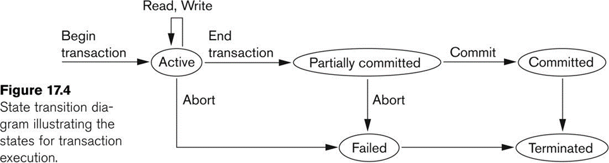
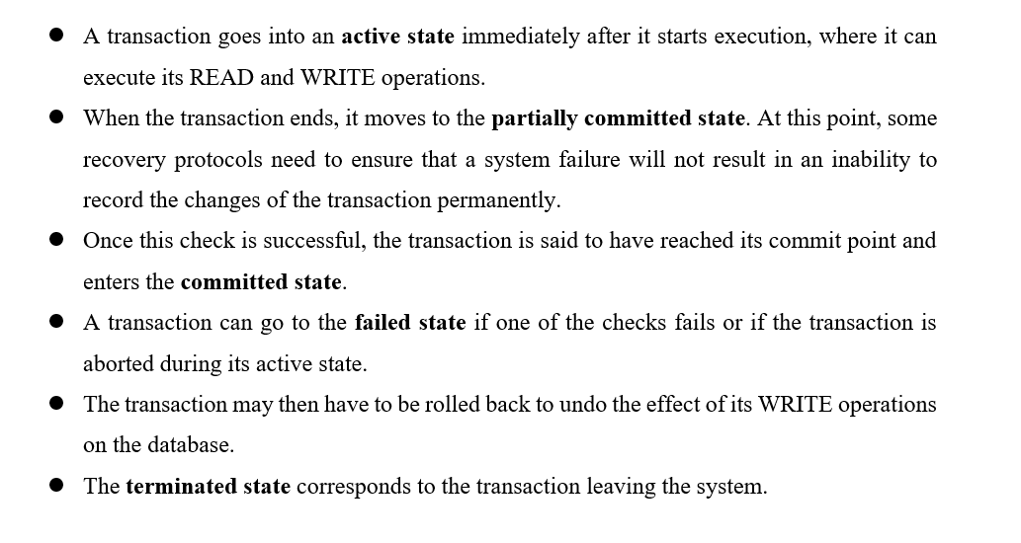

Slide 19
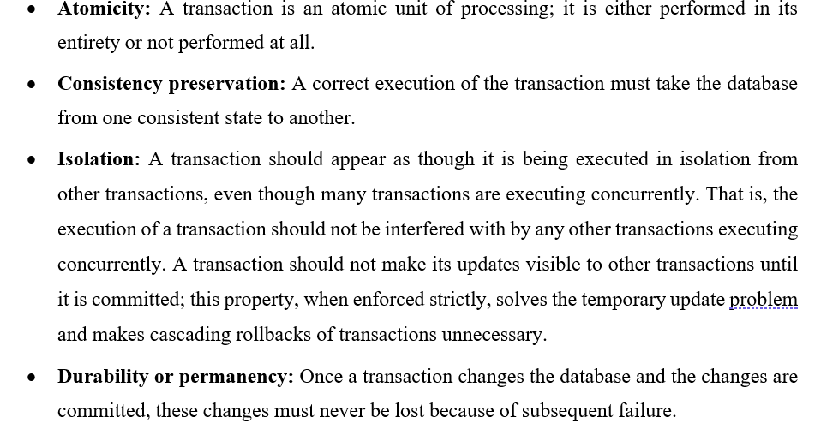
ACID Properties (Desirable Properties of Transactions)

Slide 20
The System Log(Journal)
The log keeps track of all transaction operations that affect the values of database items.
This information may be needed to permit recovery from transaction failures.
The log is kept on disk, so it is not affected by any type of failure except for disk or catastrophic failure.

Slide 21
Types of log record
[start_transaction,T]: Records that transaction T has started execution.
[write_item,T,X,old_value,new_value]: Records that transaction T has changed the value of database item X from old_value to new_value.
[read_item,T,X]: Records that transaction T has read the value of database item X.
[commit,T]: Records that transaction T has completed successfully, and affirms that its effect can be committed (recorded permanently) to the database.
[abort,T]: Records that transaction T has been aborted.
[Note: T refers to a unique transaction-id that is generated automatically by the system and is used to identify each transaction]

Slide 22
Recovery Using Log Records:
If the system crashes, we can recover to a consistent database state by examining the log.
1. Because the log contains a record of every write operation that changes the value of some database item, it is possible to undo the effect of these write operations of a transaction T by tracing backward through the log and resetting all items changed by a write operation of T to their old_values.
2. We can also redo the effect of the write operations of a transaction T by tracing forward through the log and setting all items changed by a write operation of T (that did not get done permanently) to their new_values.

Slide 23
Commit Point of a Transaction:
A transaction T reaches its commit point when all its operations that access the database have been executed successfully and the effect of all the transaction operations on the database has been recorded in the log.
Beyond the commit point, the transaction is said to be committed, and its effect is assumed to be permanently recorded in the database.
The transaction then writes an entry [commit,T] into the log.

Slide 24
Roll Back of Transactions: Needed for transactions that have a [start_transaction,T] entry into the log but no commit entry [commit,T] into the log.
Redoing Transactions: Transactions that have written their commit entry in the log must also have recorded all their write operations in the log; otherwise they would not be committed, so their effect on the database can be redone from the log entries.
Force Writing a Log: before a transaction reaches its commit point, any portion of the log that has not been written to the disk yet must now be written to the disk. This process is called force- writing the log file before committing a transaction.

Slide 25
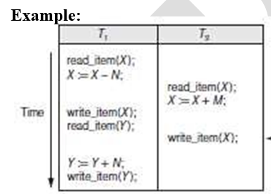
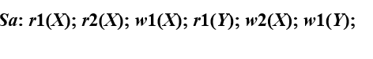
Transaction Schedule or History
When transactions are executing concurrently in an interleaved fashion, the order of execution of operations from the various transactions forms what is known as a transaction schedule (or history).
Operations from different transactions can be interleaved in the schedule S.
However, for each transaction Ti that participates in the schedule S, the operations of Ti in S must appear in the same order in which they occur in Ti.

Slide 26
Characterizing Schedules Based on Recoverability
1. Irrecoverable and Recoverable Schedule
2. Cascadeless Schedule
3. Strict Schedule

Slide 27
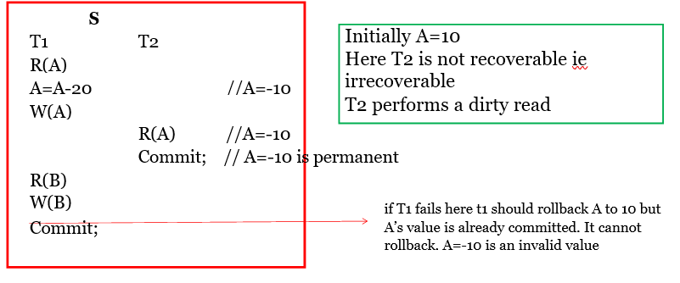
Irrecoverable Schedule
If a transaction Tj reads a data item written by transaction Ti and commit operation of T j is before the commit of Ti, then such schedules are irrecoverable

Slide 28
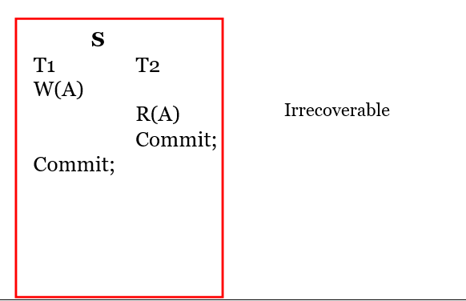

Slide 29
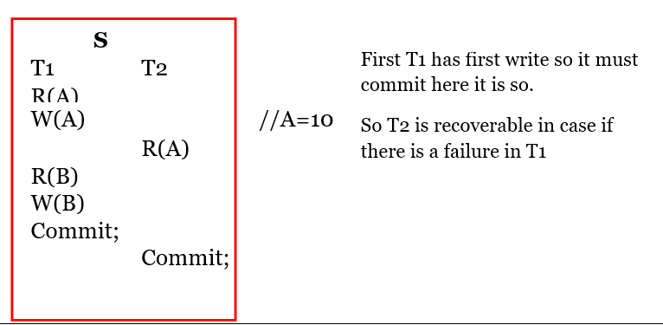
Recoverable Schedule
If a transaction Tj reads a data item written by transaction Ti, then the commit operation of T j should happen only after the commit Ti, then such schedules are recoverable
That is Writer_transaction should commit first, then Reader_transaction commit (Recoverable Schedules)

Slide 30
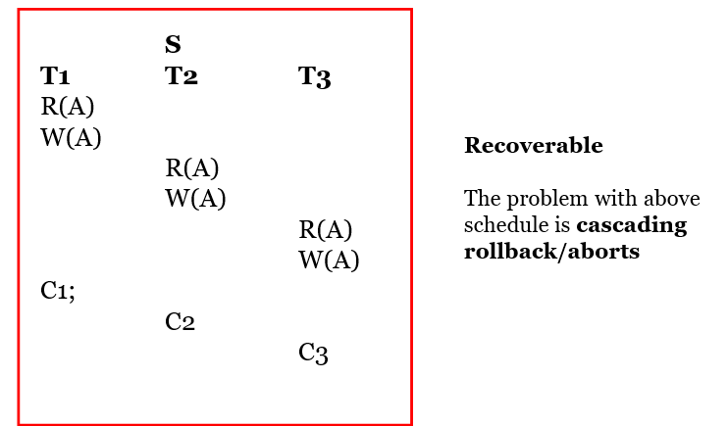
Cascading Rollbacks
Because of a single failure in a particular transaction, if all dependent transactions need to be rolled back, it is called as cascading rollbacks
Such schedules are recoverable, but can be time consuming since numerous transaction csn be rolled back
Complete waste of work, time and resources
To avoid cascading rollbacks, we need Cascadeless schedules

Slide 31
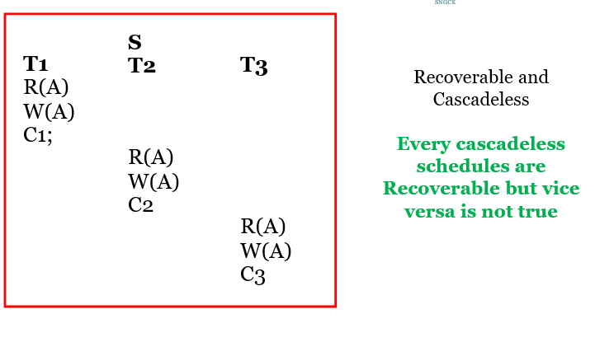
Cascadeless Schedule
Schedule which are free from Cascading Rollbacks
If every transaction in the schedule reads only items that were written by committed transaction, then such a schedule is called Cascadeless schedules

Slide 32
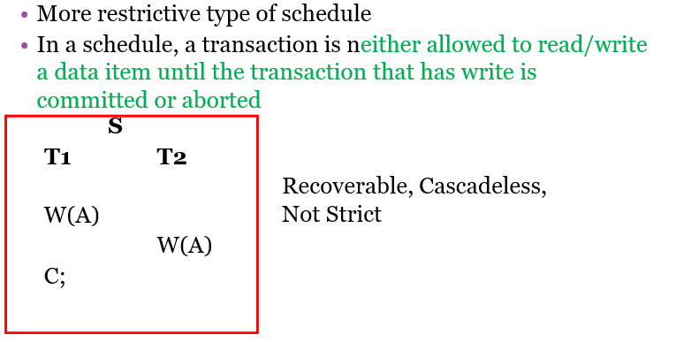
Strict Schedule

Slide 33
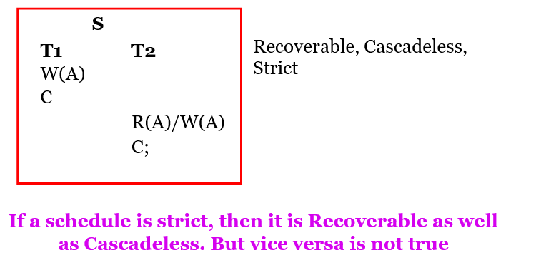

Slide 34
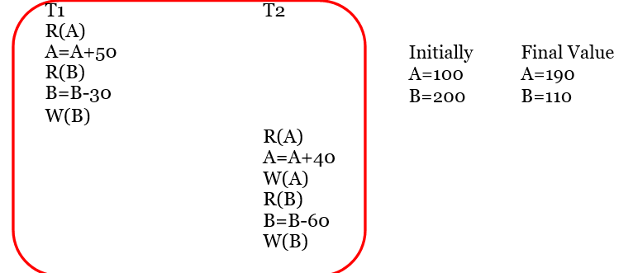
Characterizing Schedules Based on Serializability
SERIAL SCHEDULE
Entire transactions are performed in serial order
Only One transaction is active at a time
Every serial schedule is considered as correct if the transactions are independent
It does not matter which transaction is executed first
All these serial schedules are correct schedules

Slide 35
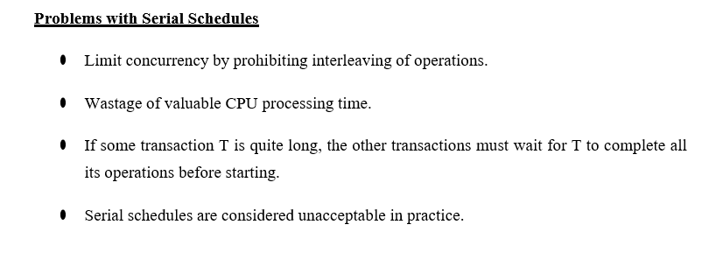

Slide 36
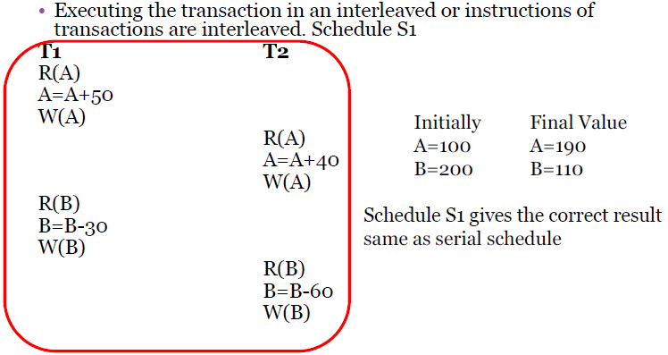
2. Non Serial schedule

Slide 37
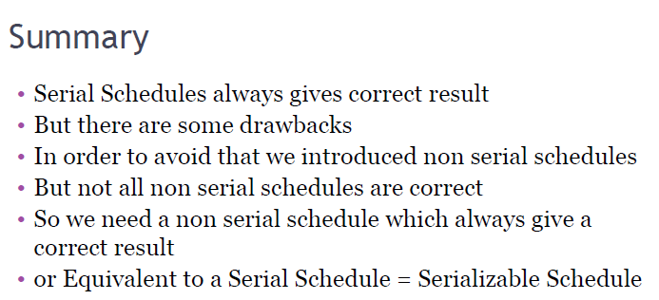

Slide 38
3. Serializable Schedules
A non serial schedule of n transactions is said to be serializable if it is equivalent to some serial schedule of same n transactions
Every serializable schedules are considered as correct
When are two schedules considered equivalent?
1.Result equivalence
2.Conflict equivalence
3.View equivalence

Slide 39
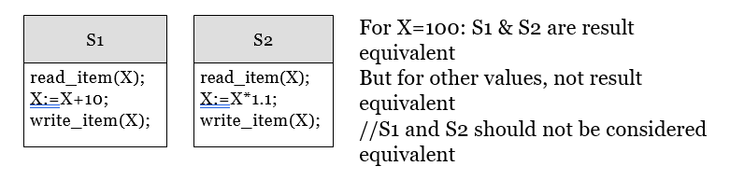
Result equivalence
Result equivalent: Two schedules are called result equivalent if they produce the same final state of the database.

Slide 40
Conflict equivalence
Conflict Operations
Two operations in a schedule are said to conflict if they satisfy
1. They belong to different transactions
2. They access the same data item
3. At least one of the operation is a write operation

Slide 41
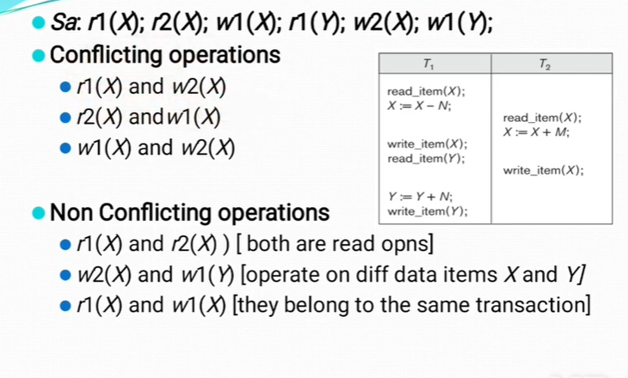

Slide 42
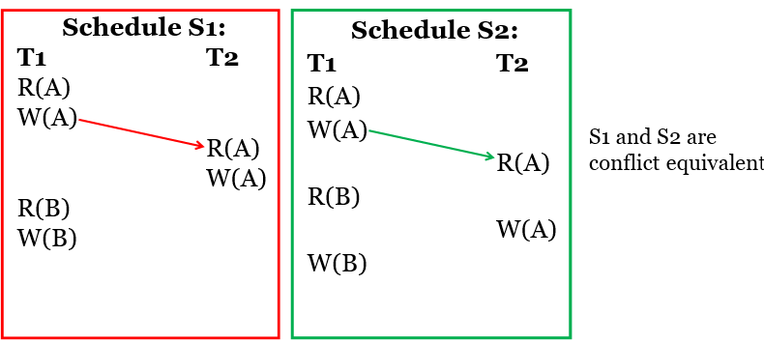
Conflict equivalence
Two schedules are said to be conflict equivalent if the relative order of any two conflicting operations is the same in both schedules

Slide 43
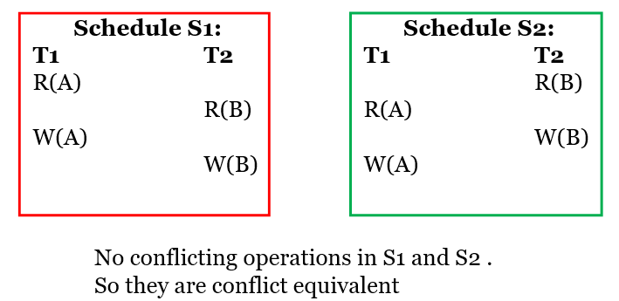
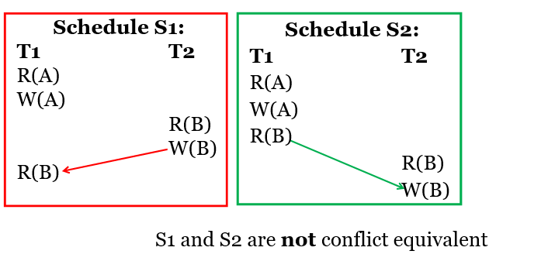

Slide 44
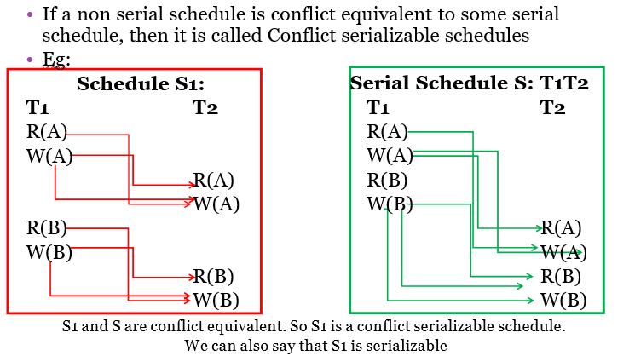
Conflict Serializable Schedule

Slide 45
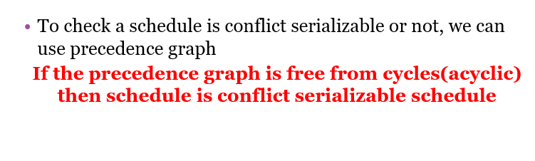
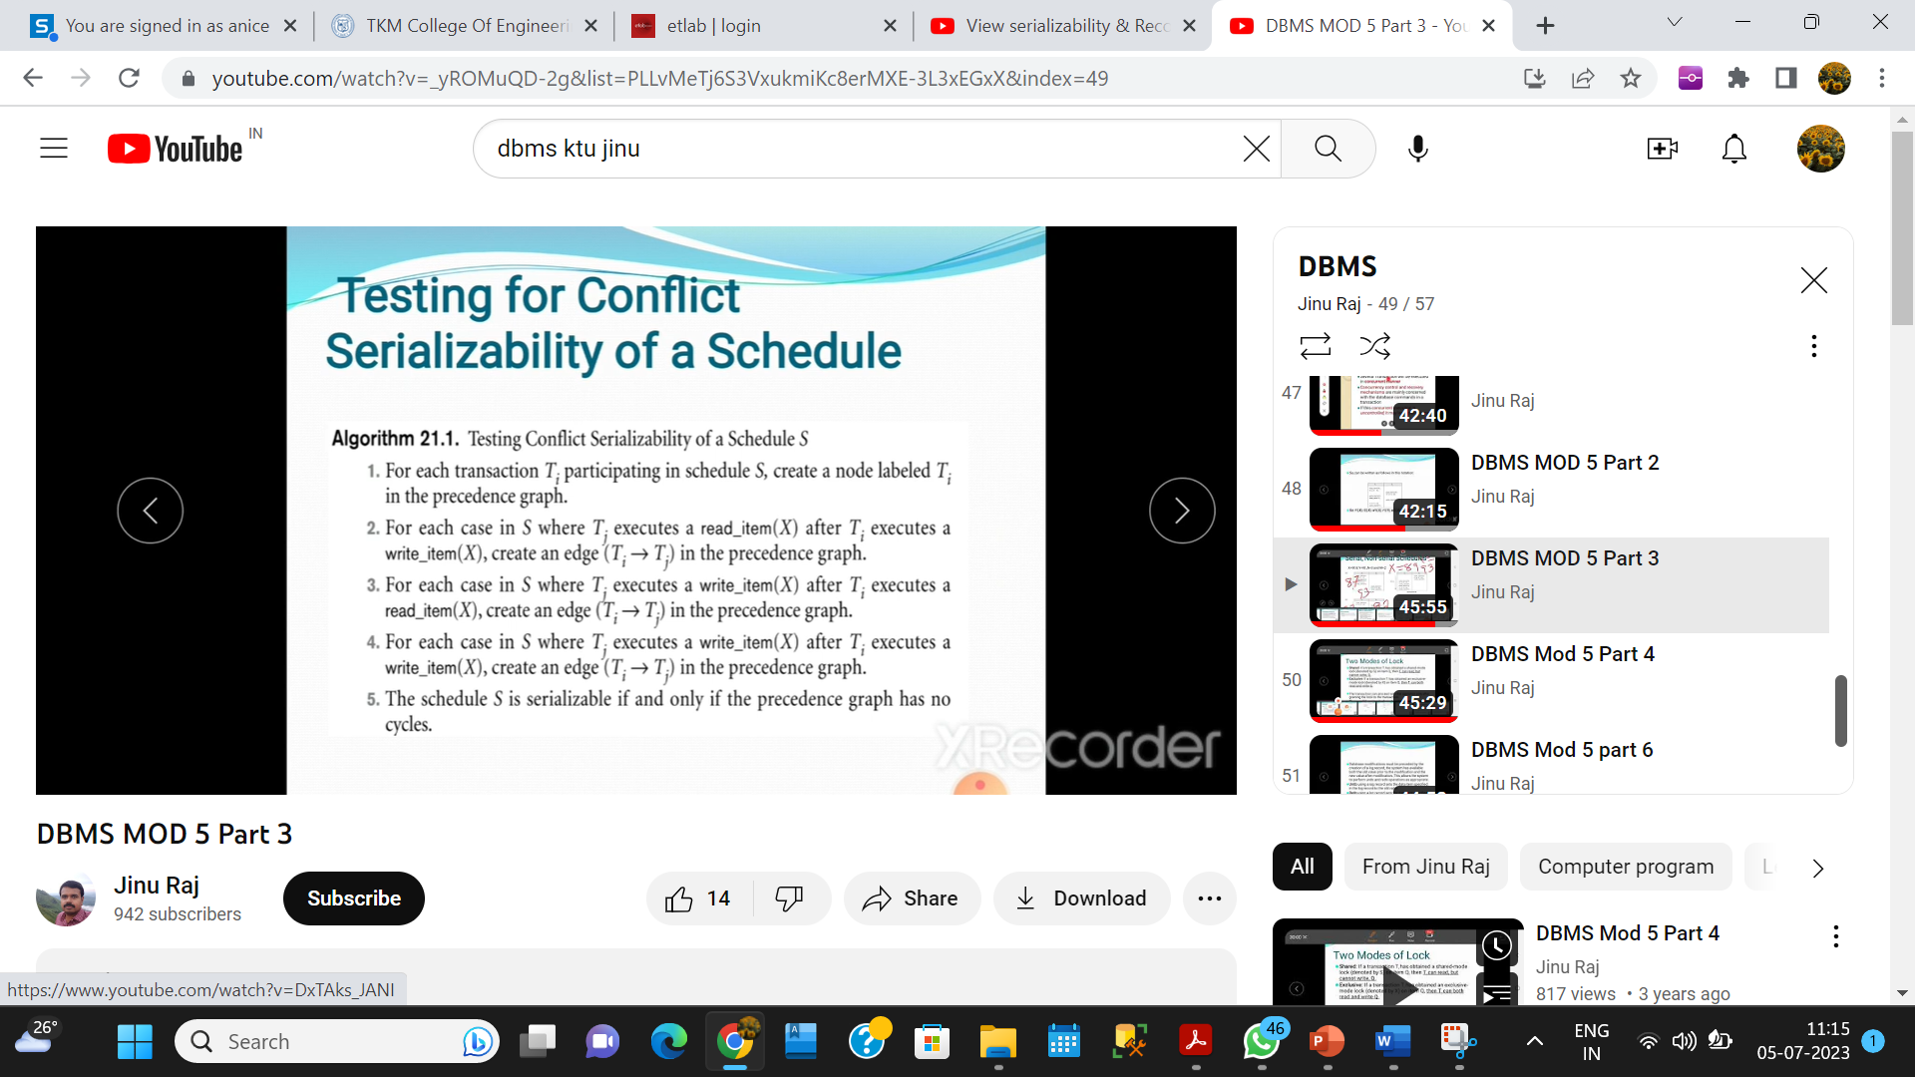

Slide 46
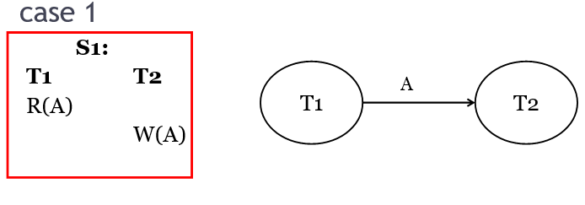
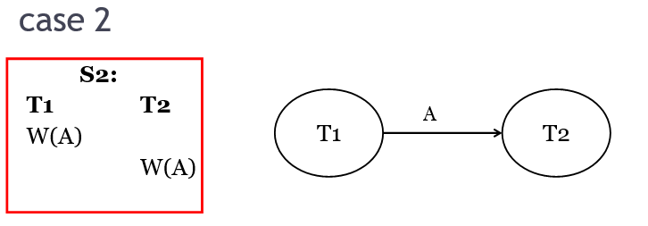
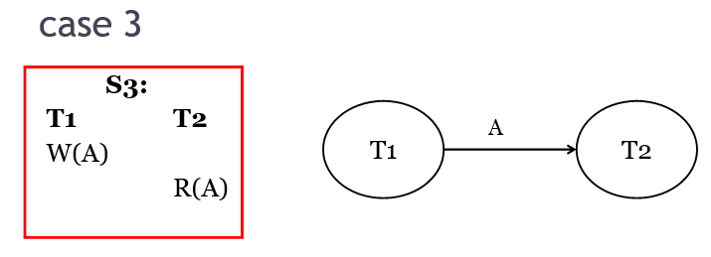
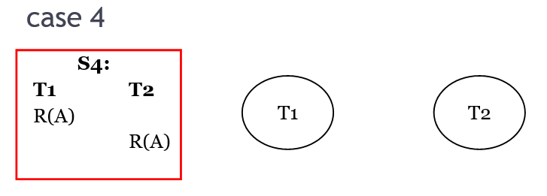
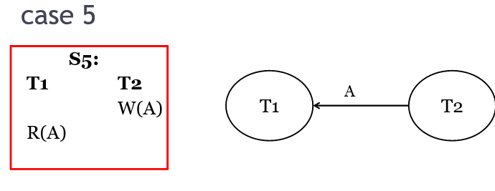

Slide 47
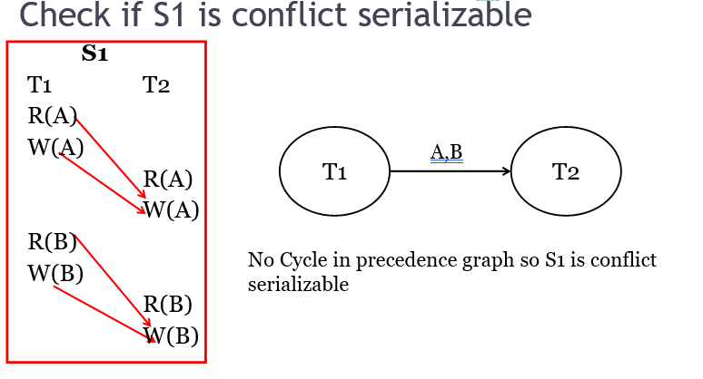
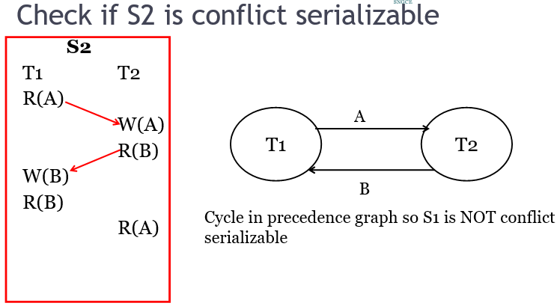

Slide 48
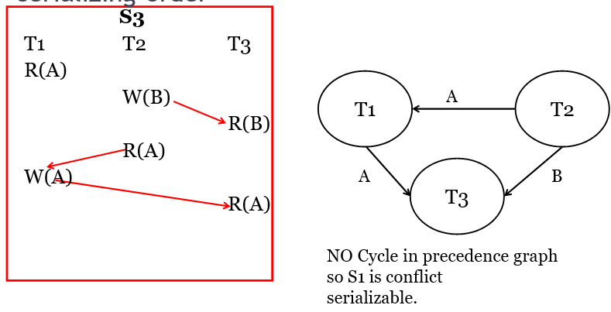
Check if S3 is conflict serializable and find its serializing order.

Slide 49
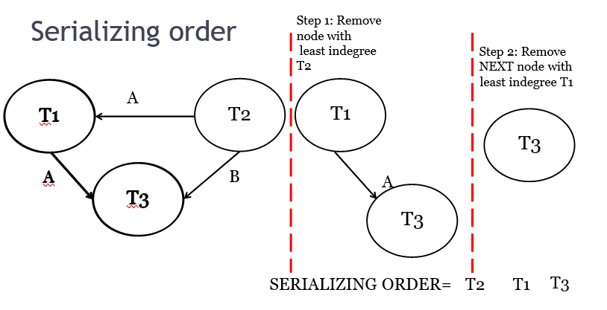

Slide 50
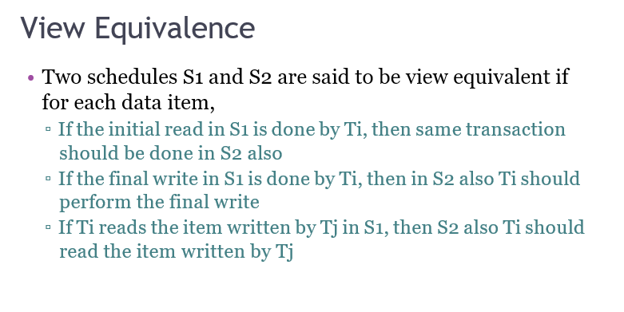

Slide 51

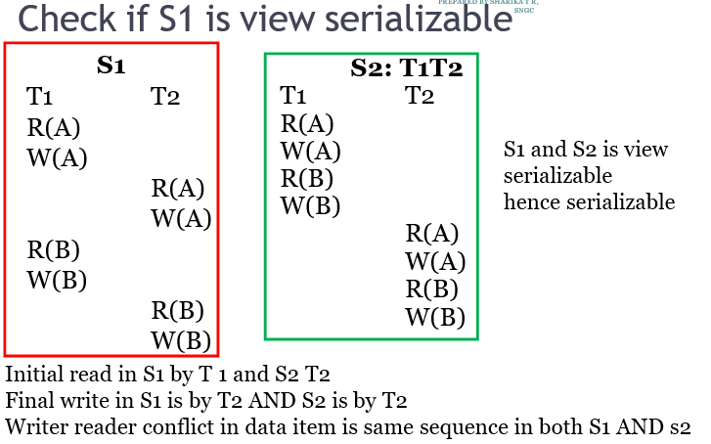

Slide 52
• Every Conflict serializable schedule is View Serializable but vice versa is not true
• Every Conflict Serializable schedule is Serializable but vice versa is not true
• Every View Serializable schedule is serializable and vice versa is also true

Slide 53
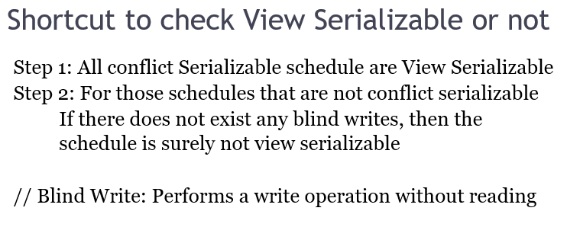

Slide 54
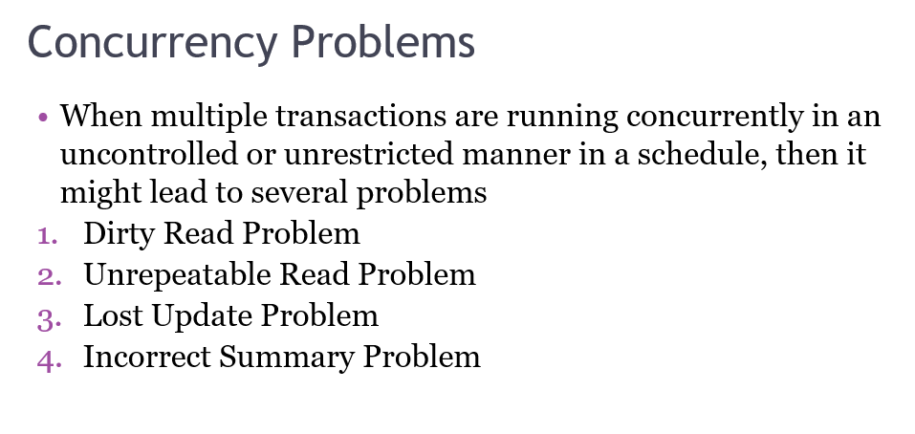

Slide 55
CONCURRENCY CONTROL PROTOCOLS
Serial schedules are correct but they are unacceptable
We can have a number of no serial schedules
We need a non serial schedule which is equivalent to some of the serial schedule ----> Serializable Schedule
To check whether a given schedule is serializable or not, we can use conflict equivalence test and view equivalence test
In order to achieve serializability and to prevent the occurrence of concurrency problems in non serial schedules we are using the concurrency control protocols
If every individual transaction follows concurrency control protocol then all schedules in which those transaction participate become serializable

Slide 56
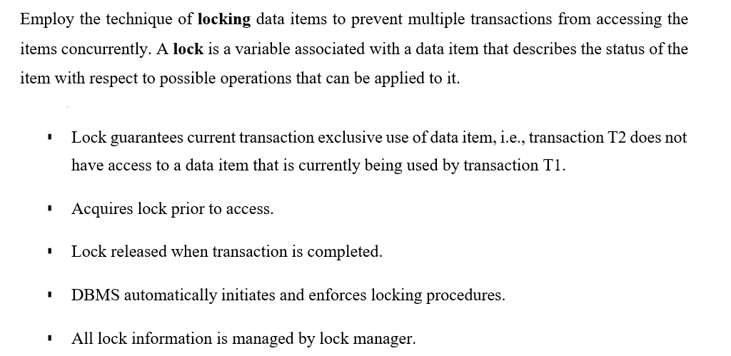

Slide 57
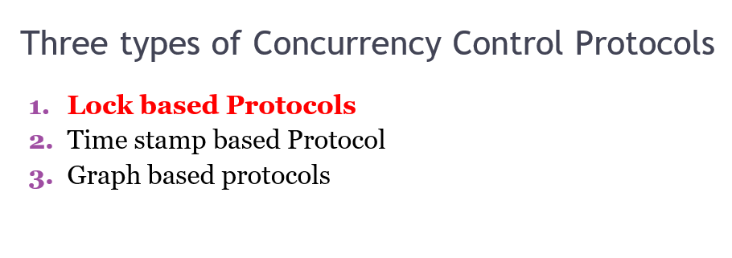

Slide 58
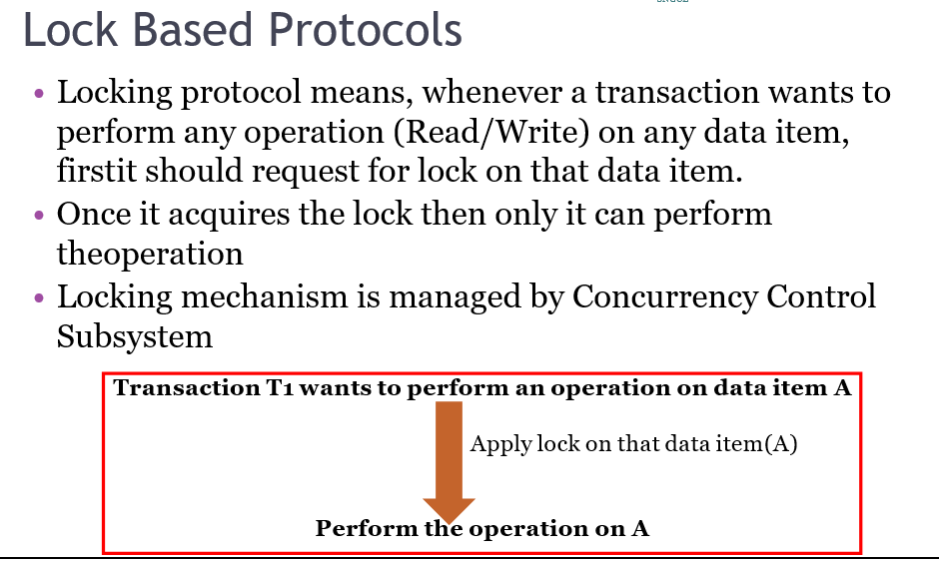
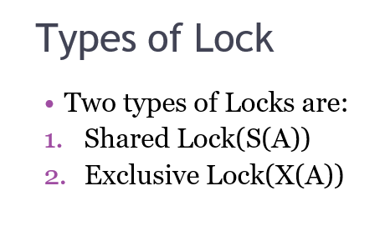

Slide 59
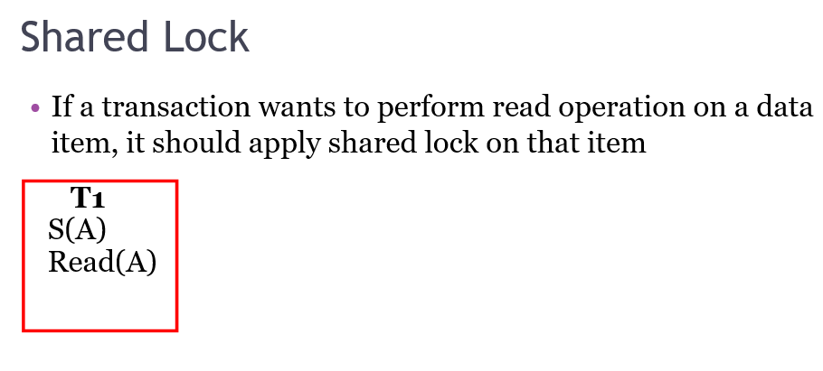


Slide 60



Slide 61


Multiple shared locks on same data item are allowed, but all other combinations are not allowed

Slide 62


Slide 63


Slide 64


Slide 65


Slide 66


Slide 67


Slide 68


Slide 69



Slide 70

Problems with Basic 2PL
1. Basic 2PL does not ensure Recoverability

Slide 71

2. Cascading rollbacks are possible

Slide 72

3. Deadlocks are possible

Slide 73

These drawback can be removed by using the following variation of basic 2PL
We have to solve Recoverability, Cascading Rollbacks and Deadlock

Slide 74

Strict 2PL is not deadlock-free.

Slide 75

Example:

Slide 76


Slide 77



Slide 78


Slide 79



Slide 80



Slide 81
Storage Structure
Volatile storage. Information residing in volatile storage does not usually survive system crashes. Examples of such storage are main memory and cache memory. Access to volatile storage is extremely fast, both because of the speed of the memory access itself, and because it is possible to access any data item in volatile storage directly.
Nonvolatile storage. Information residing in nonvolatile storage survives system crashes. Examples of nonvolatile storage include secondary storage devices such as magnetic disk and flash storage, used for online storage, and tertiary storage devices such as optical media, and magnetic tapes, used for archival storage. At the current state of technology, nonvolatile storage is slower than volatile storage, particularly for random access. Both secondary and tertiary storage devices, however, are susceptible to failure which may result in loss of information

Slide 82
Stable storage. Information residing in stable storage is never lost. Although stable storage is theoretically impossible to obtain, it can be closely approximated by techniques that make data loss extremely unlikely. To implement stable storage, we replicate the information in several non-volatile storage media (usually disk) with independent failure modes. Updates must be done with care to ensure that a failure during an update to stable storage does not cause a loss of information

Slide 83


Slide 84


Slide 85
Deferred database modification
If a transaction does not modify the database until it has committed, it is said to use the deferred- modification technique.
The deferred database modification scheme records all modifications to the log, but defers all the writes to after partial commit.
Deferred modification has the overhead that transactions need to make local copies of all updated data items; further, if a transaction reads a data item that it has updated, it must read the value from its local copy.

Slide 86


Slide 87


Slide 88



Slide 90


Slide 91


Slide 92


Slide 93

SEQUENCE OF ACTIONS IN CHECKPOINTING

Slide 94


Slide 95


Slide 96


Slide 97


Slide 98


Slide 99


Slide 100

Features of NoSQL

Slide 101


Slide 102


Slide 103


Slide 104


Slide 105


Slide 106


Slide 107


Slide 108


Slide 109


Slide 110


Slide 111


Slide 112


Slide 114


Slide 115


Slide 116


Slide 117


